Slide 1
Chemistry – Feb 11, 2020
Get out Lewis Structures WS
For a HMK check.
P3 Challenge-
Determine the covalent Lewis structure for the nitrate ion.
Objective –
Intermolecular forces (IMF)
Assignment: Keep working with polyatomic ions
Next time: IMF Station Lab
Agenda
Polyatomic ion quiz
Lewis Structures HMK review
Chemical formulas
Inter – vs Intra – molecular
Types of IMF Intro

Slide 2
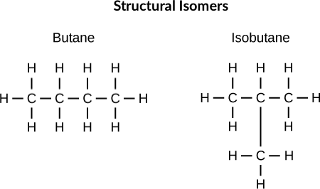
Isomers
When there is more than one way for the same set of atoms to be connected, the different possibilities are called isomers.
Isomers will have the same chemical formula but different Lewis structures
Ex: 2 Isomers of C₄H₁₀

Slide 3
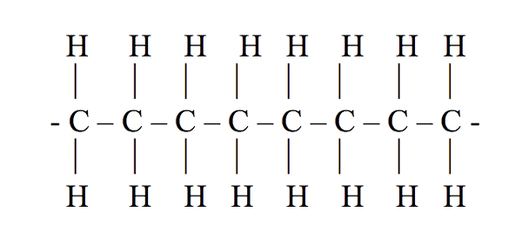
Polymers
A compound with a repeating simple unit is called a polymer. The simple unit is called the monomer.
Ex: Polyethene
Nearly all plastics are polymers.
Nearly all biological molecules are polymers.
Carbohydrates, Proteins, DNA

Slide 4
Compound formation – metals and nonmetals - REVIEW
Ionic compounds form between metal and nonmetal elements by transferring electrons
Cation (metal ion) and anion (nonmetal ion)
Both cation and anions achieve completed octets
Two metal elements do not form compounds
Two nonmetal elements can form molecular compounds by sharing electrons
Both nonmetals get surrounded by 8 electrons
The end result of all types of bonding is a chemical formula.

Slide 5
Meaning of Chemical Formulas
Chemical Formula tells number and types of elements using subscripts and parentheses as needed
Ionic – Formula unit; a representative sample of elements in lattice
NaCl is a 1:1 ratio of sodium atoms to chlorine atoms in a matrix
Covalent – Molecular formula; number and type of atoms in one molecule
CO represents diatomic molecules, randomly oriented

Slide 6
Intermolecular forces vs Intramolecular bonds
There are many types of intermolecular forces that may occur between the particles represented by formulas.
Ionic and covalent bonds are intramolecular and occur within the particles represented by formulas.
For network/lattice solids, there is no distinction between inter- and intra-.
We will discuss IMF in decreasing strength starting with those that can be considered both inter- and intra-molecular forces.
In general, the stronger the intermolecular force (IMF) the higher the melting and boiling points.
In general, solids have the strongest IMF, gases have the weakest

Slide 7
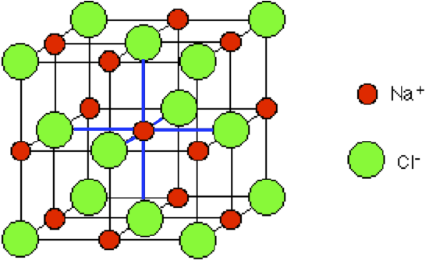
Types of Inter/Intra IMF
Type of force | Relative strength | Present in | Example
Covalent network bonding | Strongest | Only a few select substances | C
Ionic bonding | Very strong | Any ionic substances | NaCl
Metallic bonding | Variable strength, some very strong | Metals and alloys | Fe

Slide 8
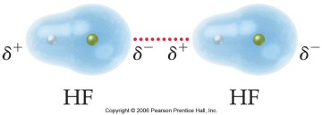
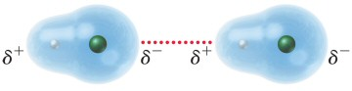
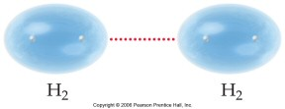
Types of Pure IMF
Type of force | Relative strength | Present in | Example
Hydrogen Bond | Strong | Molecules having H bonded to F, O, or N | HF
Dipole– Dipole force | Moderate | Only polar molecules | CO
Dispersionforce | Weak, but increases with molar mass | All atoms and molecules | H₂

Slide 9
Exit Slip - Homework
Exit Slip: none
What’s Due? (Pending assignments to complete.)
Continue studying polyatomic atoms
What’s Next? (How to prepare for the next day)
Read Holt p385-392

